Slide 1
Triple DES
This lecture is mainly based on the power point slides by Professor Lawrie Brown.
Notes:
Zili Shao

Slide 2
The Data Encryption Standard (DES)
Early 1970s: Horst Feistel designs Lucifer at IBM
1973: NBS asks for block cipher proposals.
IBM submits variant of Lucifer.
1976: NBS adopts DES as a federal standard
1997: DES broken by exhaustive search
2000: NIST adopts Rijndael as AES to replace DES
Widely deployed in banking and commerce

Slide 3
DES challenge
msg = “The unknown messages is: XXXX … “
CT = c₁ c₂ c₃ c₄
Goal: find k ∈ {0,1}⁵⁶ s.t. DES(k, m_{i}) = c_{i} for i=1,2,3
1997: Internet search -- 3 months
1998: EFF machine (deep crack) -- 56 hours (250K $)
1999: combined search -- 22 hours
2006: COPACOBANA (120 FPGAs) -- 7 days (10K $)
⇒ 56-bit ciphers should not be used !! (128-bit key ⇒ 2⁷² days)

Slide 4
Block Cipher Notation
P = plaintext block
C = ciphertext block
Encrypt P with key K to get ciphertext C
  C = E(K, P)
Decrypt C with key K to get plaintext P
  P = D(K, C)
Note: P = D(K,E(K, P)) and C = E(K, D(C, K))
  But P ≠ D(K2, E(K_{1,} P)) and C ≠ E(K2, D(K₁ , C)) when K₁ ≠ K₂
Part 1 ⎯ Cryptography <number>

Slide 5
Multiple Encryption & DES
A replacement for DES was needed
  theoretical attacks that can break it
  demonstrated exhaustive key search attacks
AES is a new cipher alternative
prior to this alternative was to use multiple encryption with DES implementations
Triple-DES is the chosen form
CEG 260, Meilin Liu
Notes:
Zili Shao
Given the potential vulnerability of DES to a brute-force attack,there has been considerable interest in finding an alternative. One approach is to design a completely new algorithm, of which AES is a prime example. Another alternative, which would preserve the existing investment in software and equipment, is to use multiple encryption with DES and multiple keys. We examine the widely accepted triple DES (3DES) approach.

Slide 6
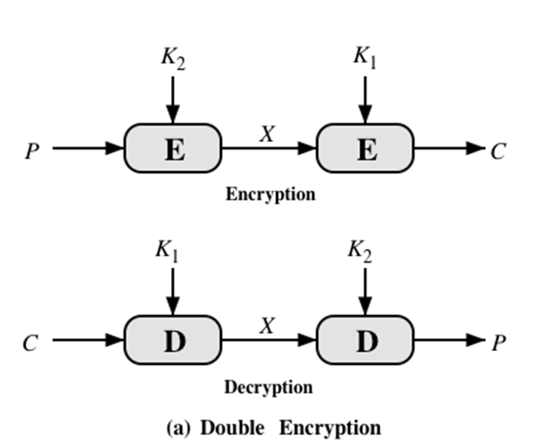
Double-DES?
Could use 2 DES encrypts on each block
  C = E(K1, E(K2, P))
Notes:
Because of its vulnerability to brute-force attack, DES, once the most widely used
symmetric cipher, has been largely replaced by stronger encryption schemes. Two
approaches have been taken. One approach is to design a completely new algorithm
that is resistant to both cryptanalytic and brute-force attacks, of which AES
is a prime example. Another alternative, which preserves the existing investment in
software and equipment, is to use multiple encryption with DES and multiple keys.
We begin by examining the simplest example of this second alternative. We then
look at the widely accepted triple DES (3DES) algorithm.
The simplest form of multiple encryption has two encryption stages and two keys
(Figure 7.1a).
Given a plaintext P and two encryption keys K₁ and K₂ , ciphertext C
is generated as
C = E(K₂ , E(K₁ , P ))
Decryption requires that the keys be applied in reverse order:
P = D(K₁ , D(K₂ , C ))
For DES, this scheme apparently involves a key length of 56 * 2 = 112 bits, and should result
in a dramatic increase in cryptographic strength. But we need to examine the
algorithm more closely.
it is reasonable to assume that if DES is used twice with different keys, it
will produce one of the many mappings that are not defined by a single application
of DES. Although there was much supporting evidence for this assumption, it was
not until 1992 that the assumption was proven [CAMP92].

Slide 7
Double-DES?
Could use 2 DES encrypts on each block
  C = E(K1, E(K2, P))
Have “meet-in-the-middle” attack
  works whenever use a cipher twice
  since X = E(K2, P) = D(K1,C)
  Pre-compute table of E(K1, P) for every possible key K1 (resulting table has 2^56 entries)
  Then for each possible K2 compute D(K2, C) until a match in table is found
  When match is found, have E(K2, P) = D(K1, C)
  Result gives us keys: C = E(K1, E(K2, P))
CEG 260, Meilin Liu
Notes:
Zili Shao
The simplest form of multiple encryption has two encryption stages and two keys - Double-DES.
Have concern that there might be a single key that is equivalent to using 2 keys as above, not likely but only finally proved in 1992.
More seriously have the “meet-in-the-middle” attack, first described by Diffie in 1977. It is a known plaintext attack (ie have know pair (P,C), and attempts to find by trial-and-error a value X in the “middle” of the double-DES encryption of this pair, and chances of this are much better at O(2^56) than exhaustive search at O(2^112).

Slide 8
Why not double DES?
Define 2E( (k₁,k₂), m) = E(k₁ , E(k₂ , m) )
Attack: Given M = (m₁,…, m₁₀) , C = (c₁,…,c₁₀).
  Find (K1, K2) such that C = E(K1, E(K2, P)) Or E(K2, P) = D(K1, C)
E(k₂,⋅)
E(k₁,⋅)
key-len = 112 bits for DES
m
c

Slide 9
Why not double DES?
Define 2E( (k₁,k₂), m) = E(k₁ , E(k₂ , m) )
Attack: M = (m₁,…, m₁₀) , C = (c₁,…,c₁₀).
step 1: build table.
sort on 2nd column
E(k₂,⋅)
E(k₁,⋅)
key-len = 112 bits for DES
m
c
  E(K2, P) = D(K1, C)
k⁰ = 00…00
k¹ = 00…01
k² = 00…10
⋮
k^{N} = 11…11
E(k⁰ , M)
E(k¹ , M)
E(k² , M)
⋮
E(k^{N} , M)
2⁵⁶
entries

Slide 10
Meet in the middle attack
E(k₂,⋅)
E(k₁,⋅)
m
c
Attack: M = (m₁,…, m₁₀) , C = (c₁,…,c₁₀)
step 1: build table.
Step 2: for all k∈{0,1}⁵⁶ do:
test if D(k, C) is in 2nd column.
  if so then E(k^{i},M) = D(k,C) ⇒ (k^{i},k) = (k₂,k₁)
k⁰ = 00…00
k¹ = 00…01
k² = 00…10
⋮
k^{N} = 11…11
E(k⁰ , M)
E(k¹ , M)
E(k² , M)
⋮
E(k^{N} , M)

Slide 11
Meet in the middle attack
E(k₂,⋅)
E(k₁,⋅)
m
c
Time = 2⁵⁶log(2⁵⁶) + 2⁵⁶log(2⁵⁶) < 2⁶³ << 2¹¹² , space ≈ 2⁵⁶
Build the table, sort
on the second column
After applying decryption with a key,
search the result in the table

Slide 12
Strengthening DES against ex. search
Triple-DES
Let E : K × M ⟶ M be a block cipher
Define 3E: K³ × M ⟶ M as
For 3DES: key-size = 3×56 = 168 bits. 3×slower than DES.
(simple attack in time ≈2¹¹⁸ )
3E( (K1,K2,K3), m) = E(K1, D(K2, E(K3, m) ) )

Slide 13
Triple-DES with Two-Keys
Can use 2 keys with E-D-E sequence
  C = C =E(K1, D(K2, E(K1, P) ) )
  encrypt & decrypt equivalent in security
  if K1=K2 then can work with single DES
Standardized in ANSI X9.17 & ISO8732
CEG 260, Meilin Liu
Notes:
Zili Shao
Triple-DES with two keys is a popular alternative to single-DES, but suffers from being 3 times slower to run. The use of encryption & decryption stages are equivalent, but the chosen structure allows for compatibility with single-DES implementations. 3DES with two keys is a relatively popular alternative to DES and has been adopted for use in the key management standards ANS X9.17 and ISO 8732. Currently, there are no practical cryptanalytic attacks on 3DES. Coppersmith notes that the cost of a brute-force key search on 3DES is on the order of 2^112 (=5*10^33) and estimates that the cost of differential cryptanalysis suffers an exponential growth, compared to single DES, exceeding 10^52.

Slide 14
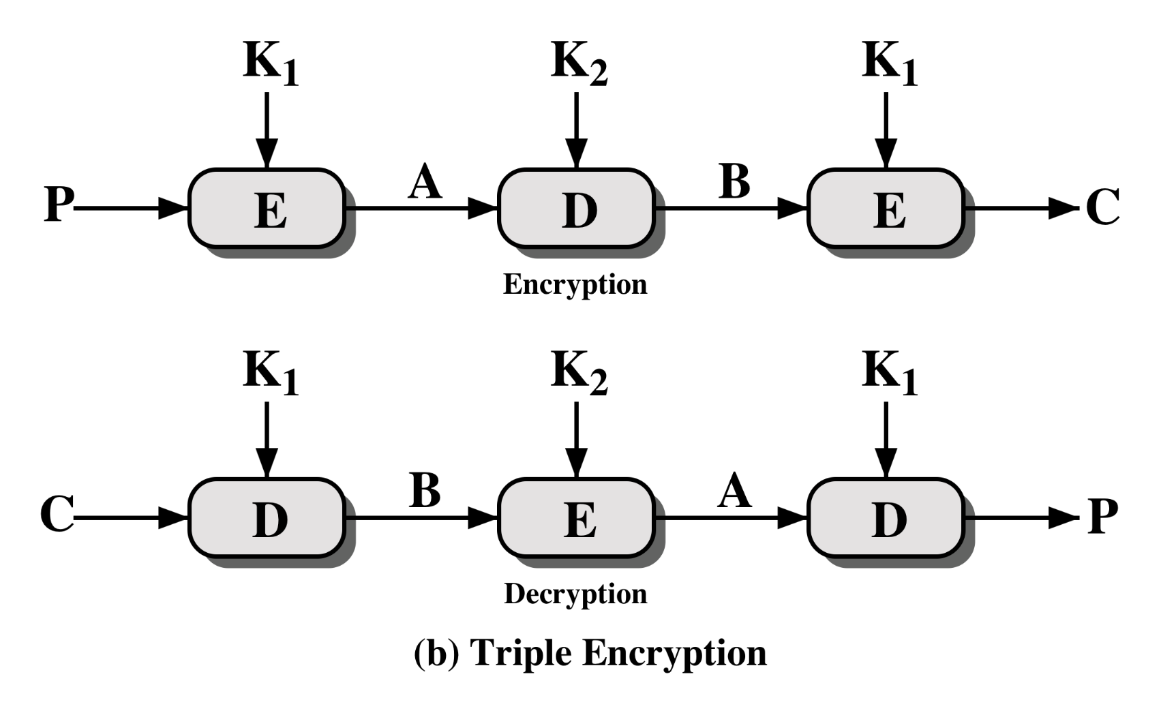
Triple-DES with Two-Keys
CEG 260, Meilin Liu
Notes:
Zili Shao
Triple-DES with two keys is a popular alternative to single-DES, but suffers from being 3 times slower to run. The use of encryption & decryption stages are equivalent, but the chosen structure allows for compatibility with single-DES implementations. 3DES with two keys is a relatively popular alternative to DES and has been adopted for use in the key management standards ANS X9.17 and ISO 8732. Currently, there are no practical cryptanalytic attacks on 3DES. Coppersmith notes that the cost of a brute-force key search on 3DES is on the order of 2^112 (=5*10^33) and estimates that the cost of differential cryptanalysis suffers an exponential growth, compared to single DES, exceeding 10^52.

Slide 15
Triple-DES with Three-Keys
Although are no practical attacks on two-key
Triple-DES have some indications
Can use Triple-DES with Three-Keys to avoid even these
  E(K1, D(K2, E(K3, P) ) ) has been adopted by some Internet applications, eg PGP, S/MIME
CEG 260, Meilin Liu
Notes:
Zili Shao
Have some indications of possible attacks on 2-key Triple-DES, as discussed in Stallings section 6.1. Triple-DES with three keys (168-bits) is now being used in some applications, including PGP and S/MIME, for greater security.

Slide 16
Meet in the middle attack
E(k₂,⋅)
E(k₁,⋅)
m
c
Time = 2⁵⁶log(2⁵⁶) + 2⁵⁶log(2⁵⁶) < 2⁶³ << 2¹¹² , space ≈ 2⁵⁶
Meeting the middle attack on 3DES: Time = 2¹¹⁸ , space ≈ 2⁵⁶
Time = 2⁵⁶log(2⁵⁶) + 2¹¹²log(2⁵⁶) = 2¹¹²log(2⁵⁶) < 2¹¹² * 64 = 2¹¹⁸ , space ≈ 2⁵⁶
E(k₃,⋅)
E(k₂,⋅)
E(k₁,⋅)
m
c

